Slide 1


FINANCIAL ANALYTICS
DONE BY :
P L NANCY

Slide 2
PROBLEM STATEMENT
Without analyzing the competition, it is difficult for a business to survive. You are tasked to analyse the competition for the management to provide better results. This data set has information on the market capitalization of the top 500 companies in India.
Serial NumberNameName of CompanyMar Cap – CroreMarket Capitalization in CroresSales Qtr – CroreQuarterly Sale in crores. Find key metrics and factors and show the meaningful relationships between attributes.

Slide 3
KEY METRICS
Market Capitalization – Mean, Median, Range, Standard Deviation and Quartiles
Sales Quarterly – Mean, Median, Range, Standard Deviation and Quartiles
Correlation between market capitalization and Sales Quarterly

Slide 4
INSIGHTS FOR MARKET CAPITALIZATION
The mean market capitalization for companies in the dataset is approximately 11,820.17 crores, while the median is 7,814.23 crores. This suggests that the distribution of market capitalization values is slightly right-skewed, with the mean being greater than the median. It indicates that there are companies with relatively higher market capitalizations that are influencing the mean.
The standard deviation of 10,028.58 crores indicates that there is significant diversity in market capitalization among the companies in the dataset. Some companies may have market capitalizations significantly higher or lower than the average.
The range of market capitalization is 45,604.3 crores. This indicates the extent of variation in market capitalization among companies, ranging from relatively small to large market values.
The first quartile (25th percentile) at 4,444.28 crores indicates that 25% of the companies have market capitalizations below this value, representing relatively smaller companies in terms of market value. The third quartile (75th percentile) at 15,232.28 crores shows that 75% of the companies have market capitalizations below this value, indicating the range within which the majority of companies fall.

Slide 5
INSIGHTS FOR Sales Quarterly
The mean quarterly sales for companies in the dataset is approximately 1254.98 crores, while the median is 793.76 crores. This indicates that the distribution of quarterly sales values is slightly right-skewed, with the mean being greater than the median. It suggests that there are some companies with relatively higher sales figures that are pulling the mean upwards.
The standard deviation of 1207.15 crores, suggests that there is a considerable spread in the sales performance of companies and Some companies may have sales figures significantly higher or lower than the average.
The range of quarterly sales is 5861.04 crores. This indicates the extent of variation in sales performance among companies in the dataset, ranging from no sales to significant revenue generation.
The first quartile (25th percentile) at 431.21 crores indicates that 25% of the companies have quarterly sales below this value, representing relatively lower sales performers. The third quartile (75th percentile) at 1682.97 crores shows that 75% of the companies have quarterly sales below this value, indicating the range within which the majority of companies fall.

Slide 6
INSIGHTS FOR CORRELATION BETWEEN MARKET CAPITALIZATION AND SALES QUARTERLY
The Pearson coefficient of 0.445 suggests a moderate positive linear relationship between market capitalization and quarterly sales. This indicates that as market capitalization increases, there is a tendency for quarterly sales to increase as well, although the relationship is not extremely strong.
With a Spearman coefficient of 0.490, there is a moderate positive relationship between market capitalization and quarterly sales. This implies that as market capitalization increases, there is a tendency for quarterly sales to increase as well, although the relationship may not strictly follow a linear pattern.
Both coefficients indicate a positive relationship between market capitalization and quarterly sales, suggesting that companies with higher market capitalizations tend to have higher quarterly sales. However, the strength of the relationship is moderate rather than strong, indicating that other factors beyond market capitalization also influence sales performance.

Slide 7
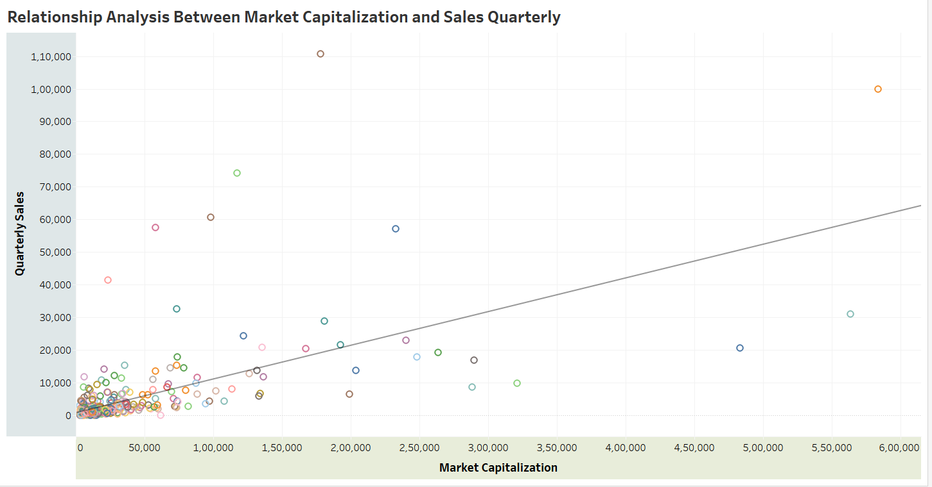
VISUALS FOR RELATIONSHIP ANALYSIS B/W MARKET CAPITALIZATION & SALES QUARTERLY

Slide 8
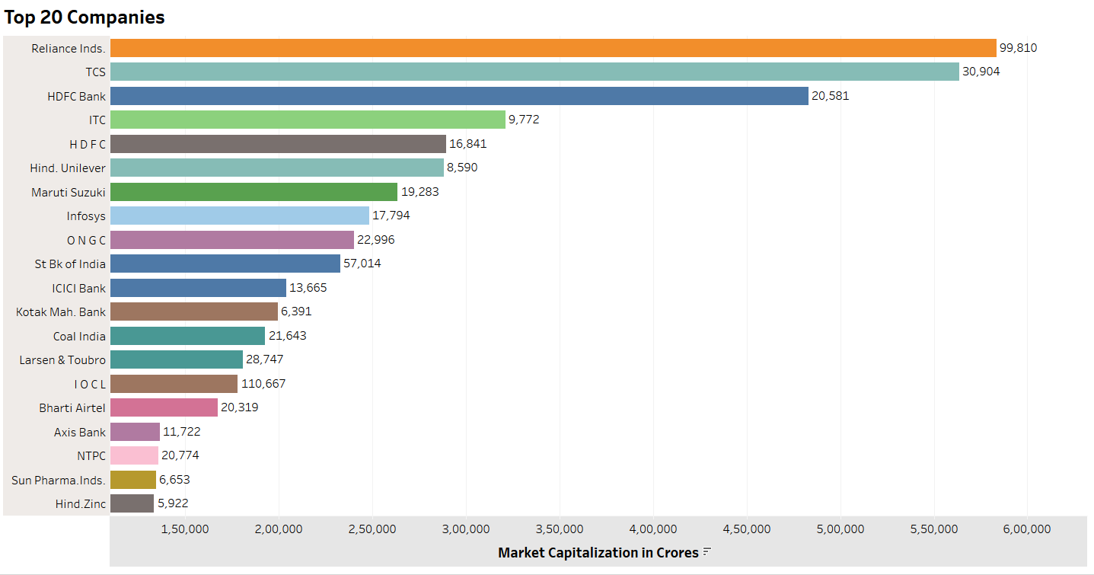
VISUALS FOR TOP 20 COMPANIES BY MARKET CAPITALIZATION

Slide 9
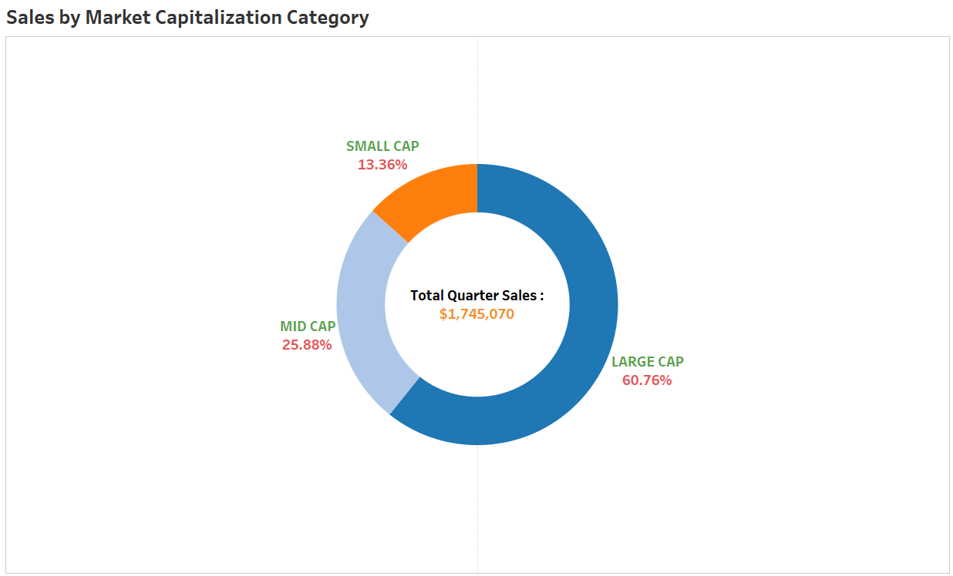
VISUALS FOR SALES BY MARKET CAPITALIZATION CATEGORY

Slide 10
CONCLUSION
The analysis of market capitalization highlights the diversity among companies, with a wide range of values ranging from relatively small to large market capitalizations. While the mean market capitalization suggests a slightly right-skewed distribution influenced by companies with higher values, the quartiles provide a deeper understanding of the spread of market values. This diversity underscores the varied market positions and sizes of companies within the dataset.
Quarterly sales data reveals varying performance among companies, with some achieving substantial sales figures while others have lower sales performance. The mean and median sales figures suggest a slightly right-skewed distribution, with some companies driving the average sales upwards. The quartiles further illustrate the spread of sales performance, indicating the range within which the majority of companies fall.
The moderate positive correlation between market capitalization and quarterly sales suggests that companies with higher market values tend to have higher sales figures. While this relationship is statistically significant, it's important to note that other factors beyond market capitalization also influence sales performance. Therefore, investors and stakeholders should consider a holistic approach when evaluating company performance and investment opportunities.
When you're investing, don't just focus on how big a company is or how much they sold recently. Check out how they compare to others in their field, and don't put all your money into just one kind of company. Stick with companies that have a good history, and think about the long run instead of what's happening right now. And always be ready for things to go a bit wrong sometimes, so you're not caught off guard.

Slide 11
THANK YOU

